Slide 1
The Grammar of Graphics
L. Wilkinson (2005)
Presented by: Sujan Dutta

Slide 2
The Grammar of Graphics
Notes:
Chomsky defined grammar as the set of rules that govern the structure of sentences in a language. A language consisting of only words without any grammatical rules can only express as many ideas as there are words. So, in a sense, grammar gives a language its expressive power. Similarly if we have a grammar for graphics we can go way beyond a set of limited charts and can explore unlimited possibilities.

Slide 3
The Grammar of Graphics
Chomsky defined grammar as the set of rules that govern the structure of sentences in a language.
A language without grammar can express only as many ideas as there are words.
Similarly a grammar of graphics can take us beyond a limited set of charts.
Notes:
Chomsky defined grammar as the set of rules that govern the structure of sentences in a language. A language consisting of only words without any grammatical rules can only express as many ideas as there are words. So, in a sense, grammar gives a language its expressive power. Similarly if we have a grammar for graphics we can go way beyond a set of limited charts and can explore unlimited possibilities.

Slide 4
The Grammar of Graphics
Are graphics just charts? No!
Charts are a predefined set of ways to represent certain types of data. They are restrictive.
The concept of graphics is much more general.

Slide 5
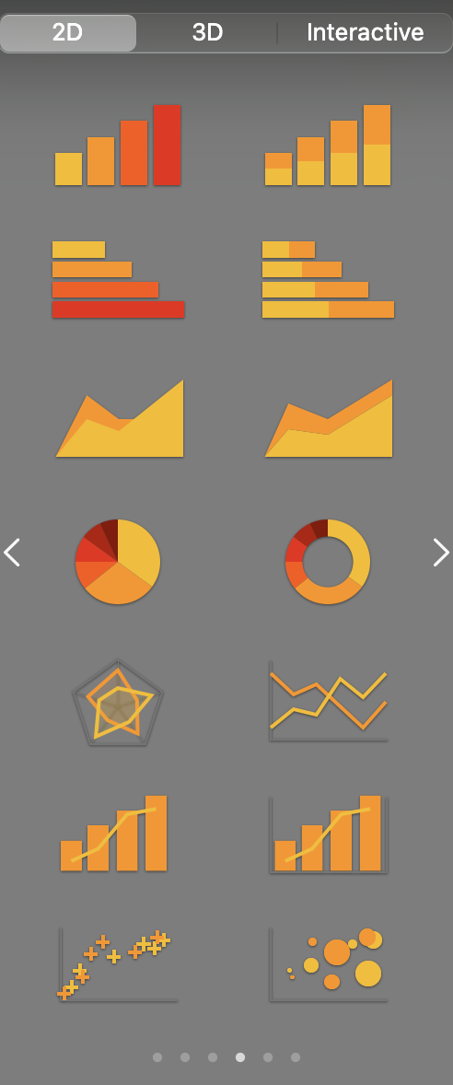
The Grammar of Graphics
Seems confusing? Here’s an example:
Using this charting program you can only generate a few types of charts.
Instead of providing a few specific charts, we want to give some simple way to produce any kind of chart!
Notes:
But how? The answer the author came up with is by using object oriented design.

Slide 6
Object Oriented Design
Objects are the building blocks of the system.
Objects are stupid (and simple), can do only a few things.
Objects can communicate with each other.
Objects can encapsulate, inherit, polymorph, etc.

Slide 7
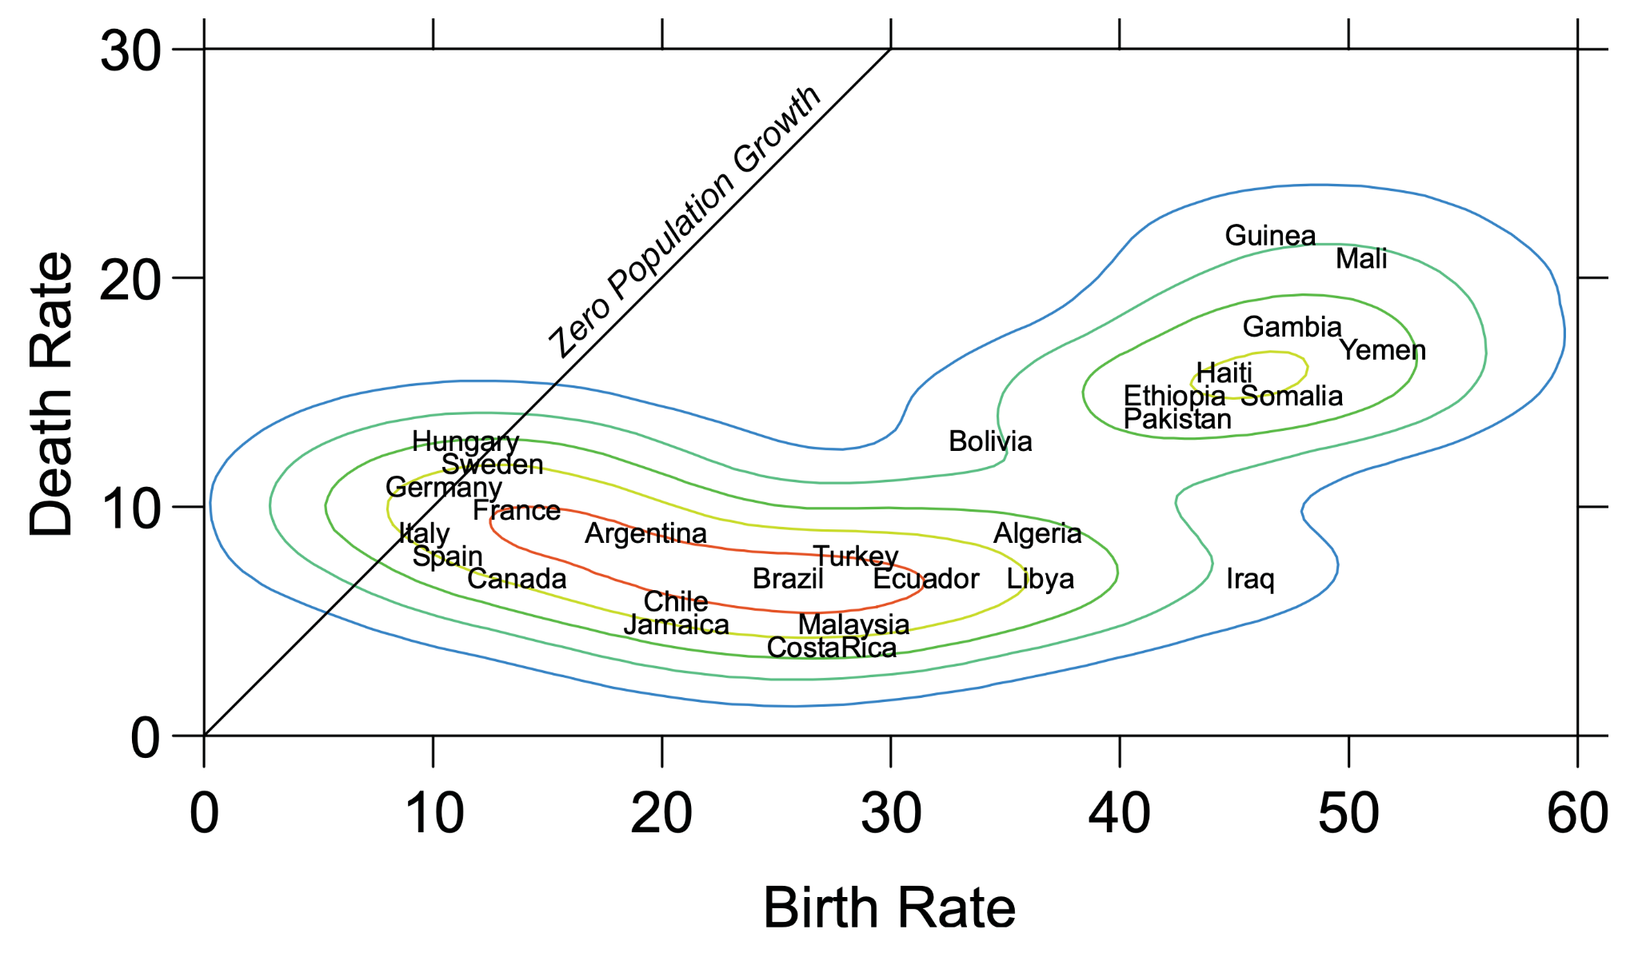
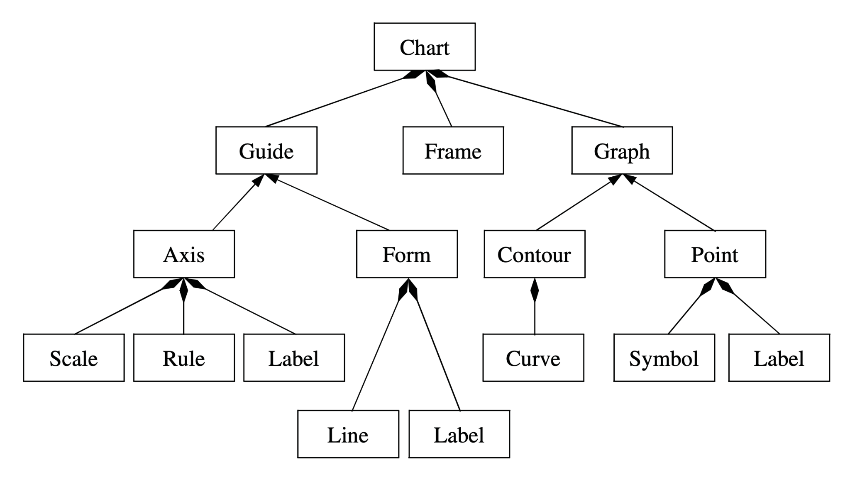
Object Oriented Graphics System
Notes:
How to read this?
Triangular arrow: “is a”, Diamond arrow: “has a”
A chart has a guide, frame and a graph. Axis is a guide and so is form. Contour is a graph.

Slide 8
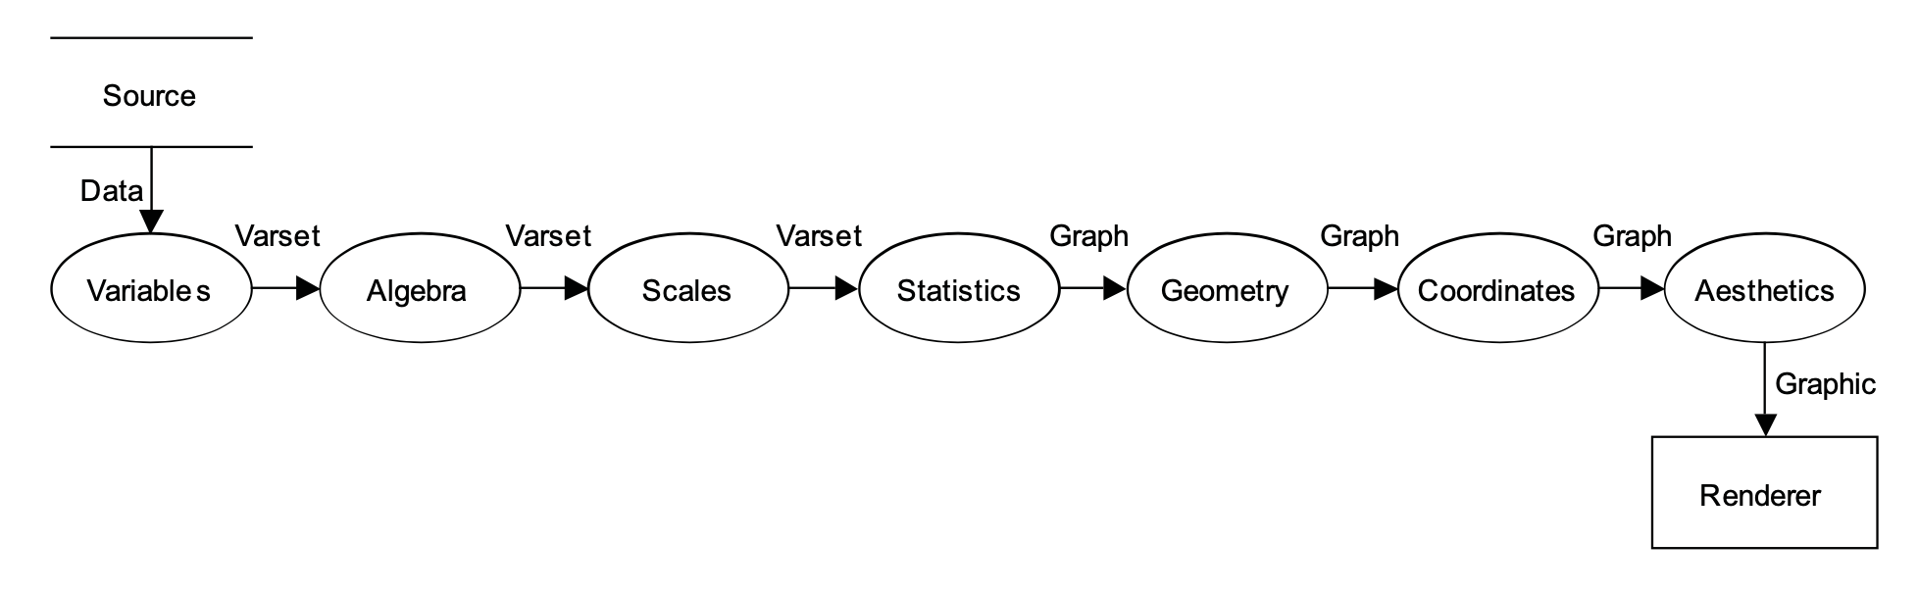
From Data to Graphic
Notes:
Describe each process with example
Mixing and matching the available processes at each step creates a wide variety of charts with a minimum of effort.
Order matters. We cannot compute scales after we do statistics, for example. And, obviously, we cannot apply aesthetics before we compute geometric objects that can be colored and textured.

